Slide 1

Sprocket Central Pty Ltd
Data analytics approach
Ankit Taklikar

Slide 2
Agenda
Introduction
Data Exploration
Model Development
Interpretation

Slide 3
Introduction
Identifying and recommending top 1000 customers to target from given datasets.
Sprocket Central Pty Ltd that specializes in high-quality bikes and accessible cycling accessories to riders.
Their marketing team is looking to boost business by analysing their existing customer dataset to determine customer trends and behaviour.
Aim is to analyse and recommend 1000 customers that should be targeted to drive the most value for the organisation.
To be done in 3 phases - Data Exploration; Model Development and Interpretation.

Slide 4
Data Exploration
Data Quality Analysis
Summary
Quality Dimensions | Customer Demographic | Customer Address | Transaction
Accuracy | DOB, Added age column |  | Added profit column
Completeness | job_title | customer_id | online_order, brand
Consistency | gender | state
Currency | deceased_indicator
Relevancy | default column |  | order_status (Cancelled)
Validity |  |  | list_price, product_first_sold_date

Slide 5
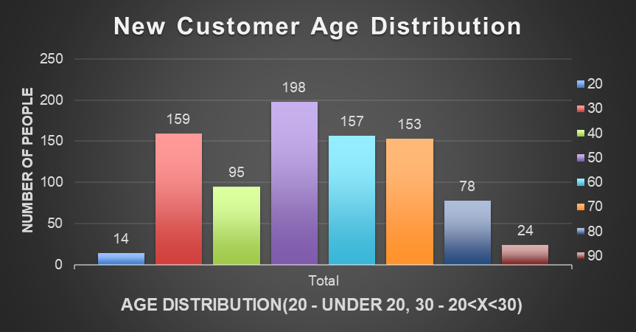
Data Exploration
Old vs New Customer Age Distribution
Most prominent age category in both old and new Dataset is 40-49
In New Customer dataset maximum amount of customers are in age category 20-29 and 40-69.
There is a significant decrease in the number of customers in age group 30-39 in New Customer dataset

Slide 6
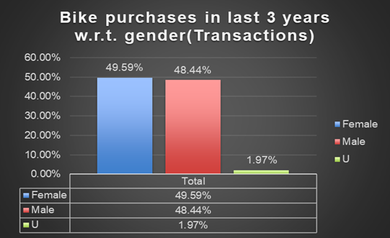
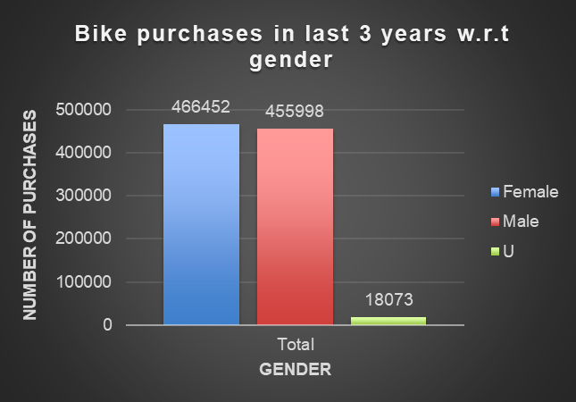
Data Exploration
Bike-related purchases in past 3 years
The first graph shows the percentage-wise distribution of bike related purchases by gender
The second graph shows the number of bike related purchases made with respect to gender
It is observed that more number of bikes are purchased by females as compared to males.

Slide 7
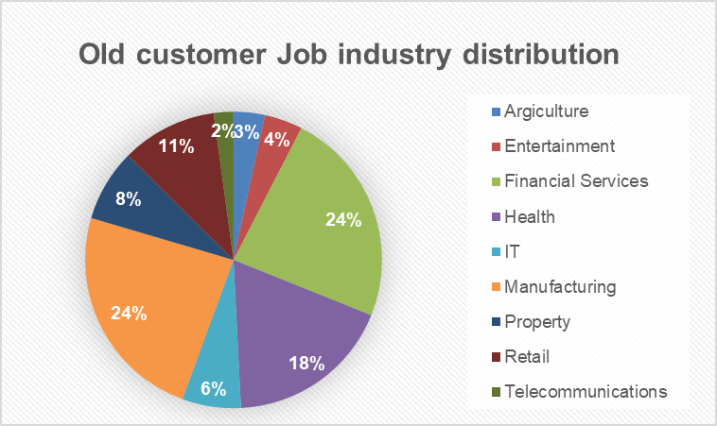
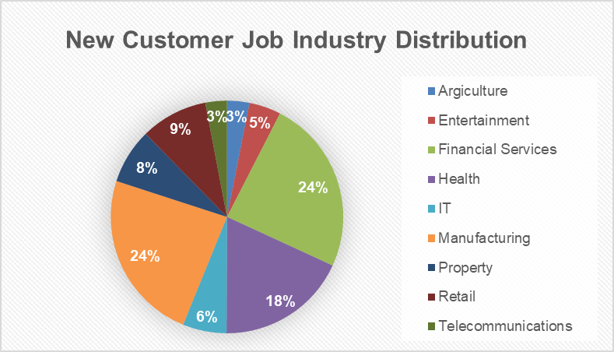
Data Exploration
Old customer vs New customer Job Industry distribution
No major changes found in bike related purchases made by customers with respect to their respective job industry
Manufacturing and Financial Services industries continue to lead in maximum number of bike related purchases with 24%
Agriculture and Telecommunications have the least number of purchases with 3%

Slide 8
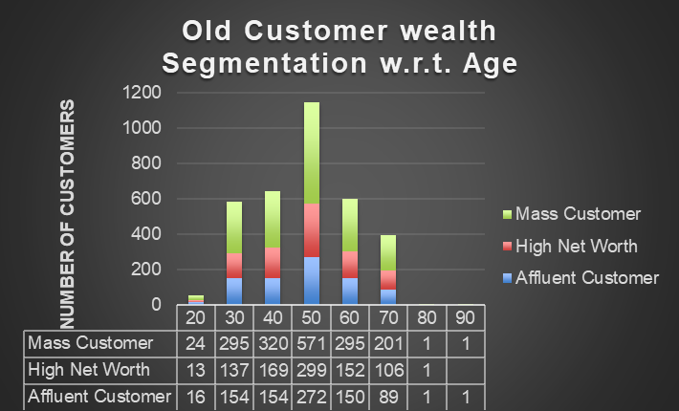
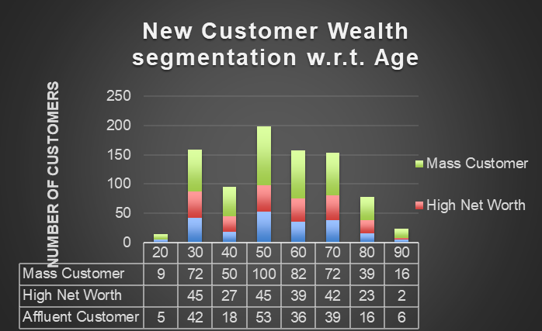
Data Exploration
Customer wealth segmentation with respect to age category
In all age categories Mass customer consists of maximum amount of customers compared to High Net Worth and Affluent customer.
The Affluent customer category surpassed the High Net Worth in the age group 40-49
Increase in the number of customers in the age group 70-79 and 80-89

Slide 9
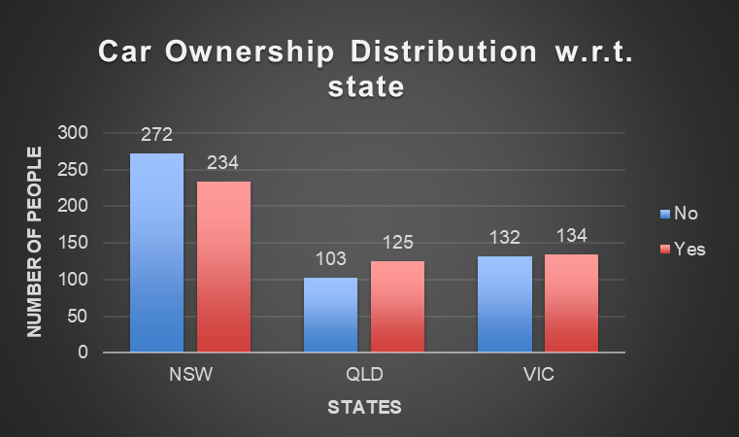
Data Exploration
Car Ownership distribution by state
In NSW number of who do not own a car is more compared to people who own a car
Majority of the data is collected from people in NSW
Whereas data collected from QLD and VIC is almost half compared to NSW
In QLD, the number of people that own a car is more than the number of people that do not
In VIC, the number of people that own or do not own a car is almost the same.

Slide 10
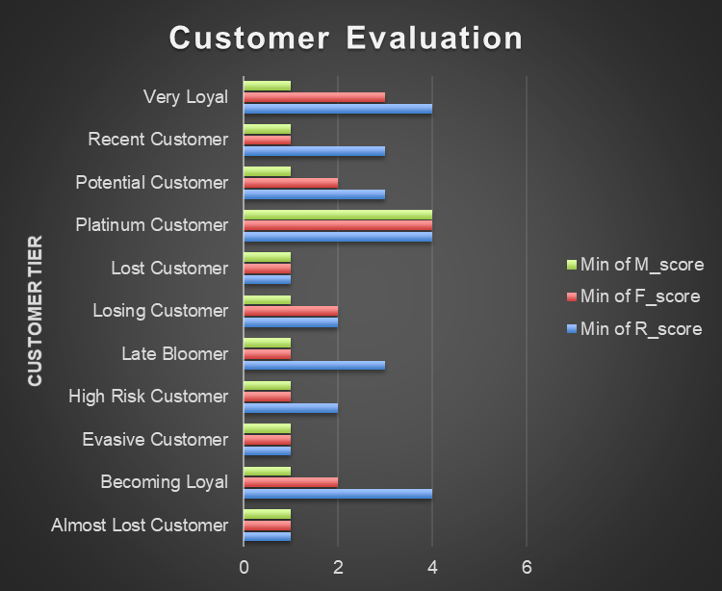
Model Development
RFM Analysis and Customer Evaluation
RFM analysis helps in identifying the customers that are to be targeted to boost revenue and to drive the most value for the organisation
The RFM (Recency, Frequency and Monetary) model is used to determine quantitatively which customers are the best ones by examining how recently a customer has purchased (recency), how often they purchase (frequency), and how much the customer spends (monetary)

Slide 11
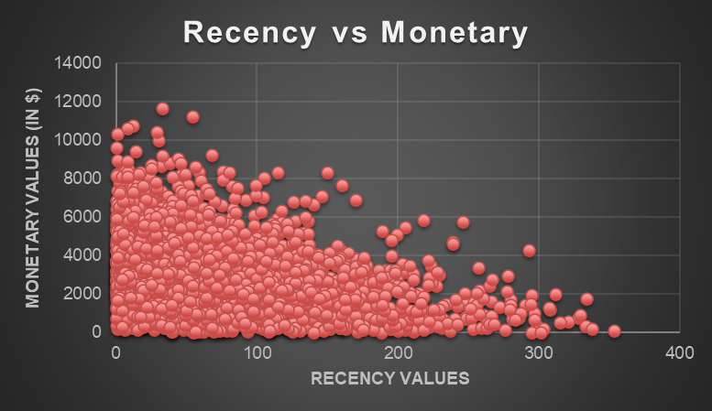
Model Development
RFM Analysis – Recency vs Monetary
It is observed that the customers who have purchased very recently have generated more revenue
The customers who have made purchases in the last 100-200 days have generated moderate revenue
The customers who have made purchases a long time ago( 200 days) have generated low revenue

Slide 12
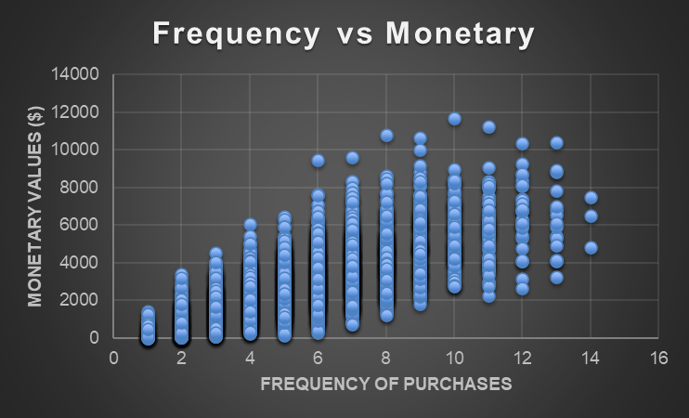
Model Development
RFM Analysis – Frequency vs Monetary
Frequency and Monetary are directly proportional to each other
Increase in frequency of purchases will result in revenue boost
The frequency of ‘Platinum Customer’, ‘Very loyal Customer’ and ‘Becoming loyal customer’ is highest

Slide 13
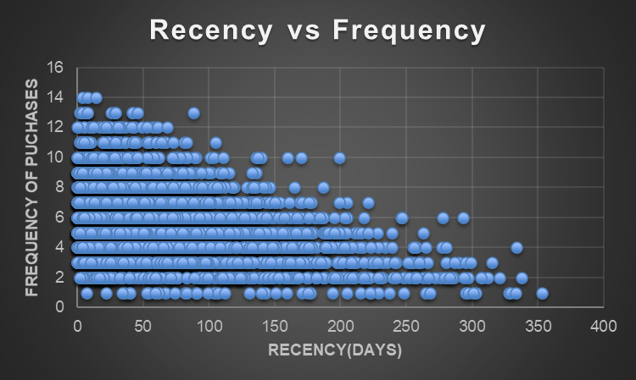
Model Development
RFM Analysis – Recency vs Frequency
Recency and Frequency are indirectly proportional to each other
The customers that visited more recently(0-100) are likely to visit more frequently(8+)
The customers with very less frequency(0-3) have very high recency values

Slide 14
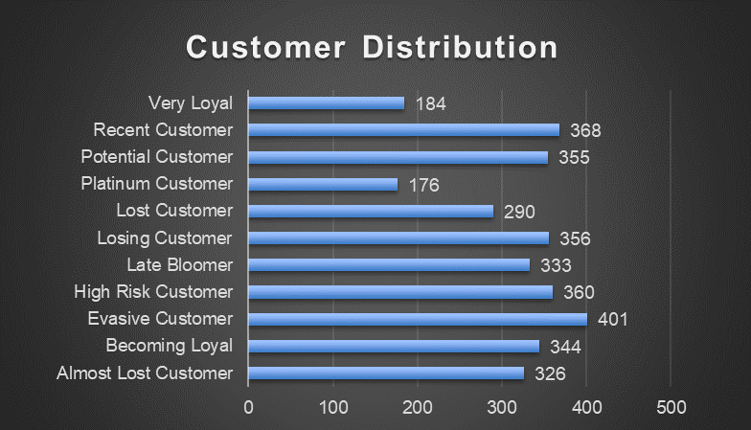
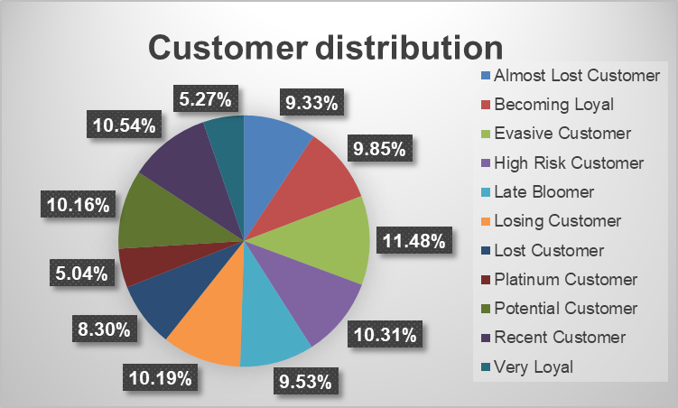
Model Development
Customer Distribution by Tier

Slide 15
Interpretation
Summary table of Top 1000 Customers to target
Rank | Customer Tier | Description | No of customers | Cumulative | Customer Selection
1 | Platinum Customer | Most recent, purchases often, most money spent | 176 | 176 | 176
2 | Very Loyal Customer | Most recent, purchases often, large amount of money spent | 184 | 360 | 184
3 | Becoming Loyal | Relatively recent, purchased more than once, large amount of money spent | 344 | 536 | 344
4 | Recent Customer | Recent, less purchasing frequency, average money spent | 368 | 1072 | 296
5 | Potential Customer | Recent, less purchasing frequency small amount spent | 355 | 1427 | 0
6 | Late bloomer | Hasn't purchased recently, but RFM greater than average | 333 | 1760 | 0
7 | Losing Customer | Hasn't purchased recently, RFM lower than average | 356 | 2116 | 0
8 | High Risk Customer | Purchased long time ago, frequency was high, large amount of money spent | 360 | 2476 | 0
9 | Almost Lost Customer | Purchased a very long time ago, very less frequency, high amount spent | 326 | 2802 | 0
10 | Evasive Customer | Purchased a very long time ago, very less frequency, low amount spent | 401 | 3203 | 0
11 | Lost Customer | Very low RFM value | 290 | 3493 | 0

Slide 16
Interpretation
Customer Target
Rank | Customer Tier | Description | No of customers | Cumulative | Customer Selection
1 | Platinum Customer | Most recent, purchases often, most money spent | 176 | 176 | 176
2 | Very Loyal Customer | Most recent, purchases often, large amount of money spent | 184 | 360 | 184
3 | Becoming Loyal | Relatively recent, purchased more than once, large amount of money spent | 344 | 536 | 344
4 | Recent Customer | Recent, less purchasing frequency, average money spent | 368 | 1072 | 296
By filtering through the datasets, the customers are segregated into various tiers
Out of these tiers the customers that are to be targeted are Platinum Customer, Very Loyal Customer, Becoming Loyal Customer and Recent customer. The total amount of these customers comes out to be 1072 out of which 1000 are selected in “Customer Selection’
These customers are the ones who have purchased recently, purchase frequently and also spend more money

Slide 17
Appendix

